Slide 1

Git and Source Control
Written by Rachel J. Morris, last updated Jan 10, 2018

Slide 2

About
In this chapter, blahblahblah

Slide 3

Topics
1. A
2. B
3. C
4. D
5. E
6. F
7. G
8. H

Slide 4
What is source control?

Slide 5

1. What is source control?
Notes
Source Control is also sometimes known as Version Control or Revision Control.
It is a tool that is (or should be) used by all developers, and by all companies that write code.
(9/10)

Slide 6
1. What is source control?
Notes
Source Control:
Save changes to server
Keep track of changes over time
Merge code together
Share code
The general idea is:
It keeps track of your changes over time.
It makes it easier to merge code together
(whether between multiple people, or if you’re working on different machines)
It makes code easier to share
Code is saved on a server, so your work shouldn’t get lost.
(9/10)

Slide 7
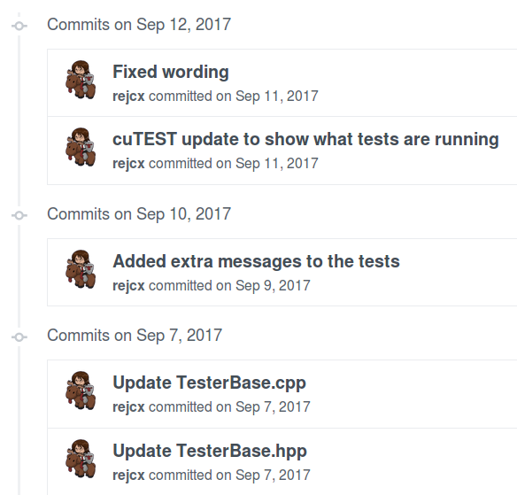
1. What is source control?
Notes
Source Control:
Save changes to server
Keep track of changes over time
Merge code together
Share code
When you have a smart system keeping track of changes over time, you can view all the changes throughout history…
List of changes made
(9/10)

Slide 8
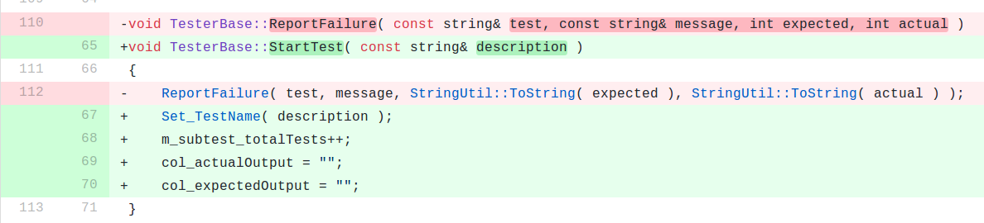
1. What is source control?
Notes
Source Control:
Save changes to server
Keep track of changes over time
Merge code together
Share code
When you have a smart system keeping track of changes over time, you can view all the changes throughout history…
Changes made to code
Red = removed
Green = added
(9/10)

Slide 9
1. What is source control?
Notes
Source Control:
Save changes to server
Keep track of changes over time
Merge code together
Share code
If you’re moving between computers, or working on the same code file at the same time as someone else, a Source Control system will merge the files as best as it can…
(9/10)

Slide 10
Conclusion
We did a thing.
Next time we do more things.

